Slide 1
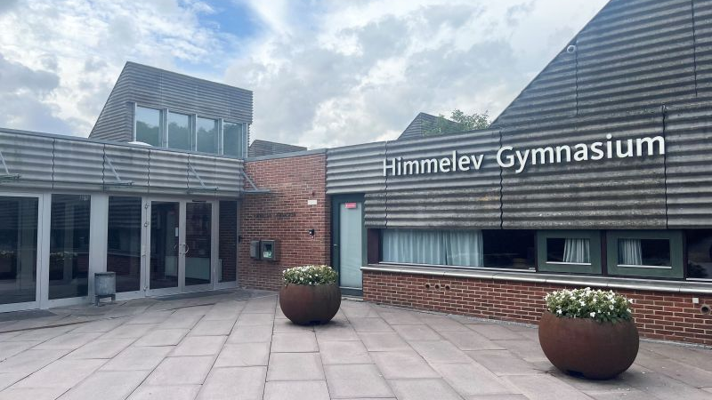
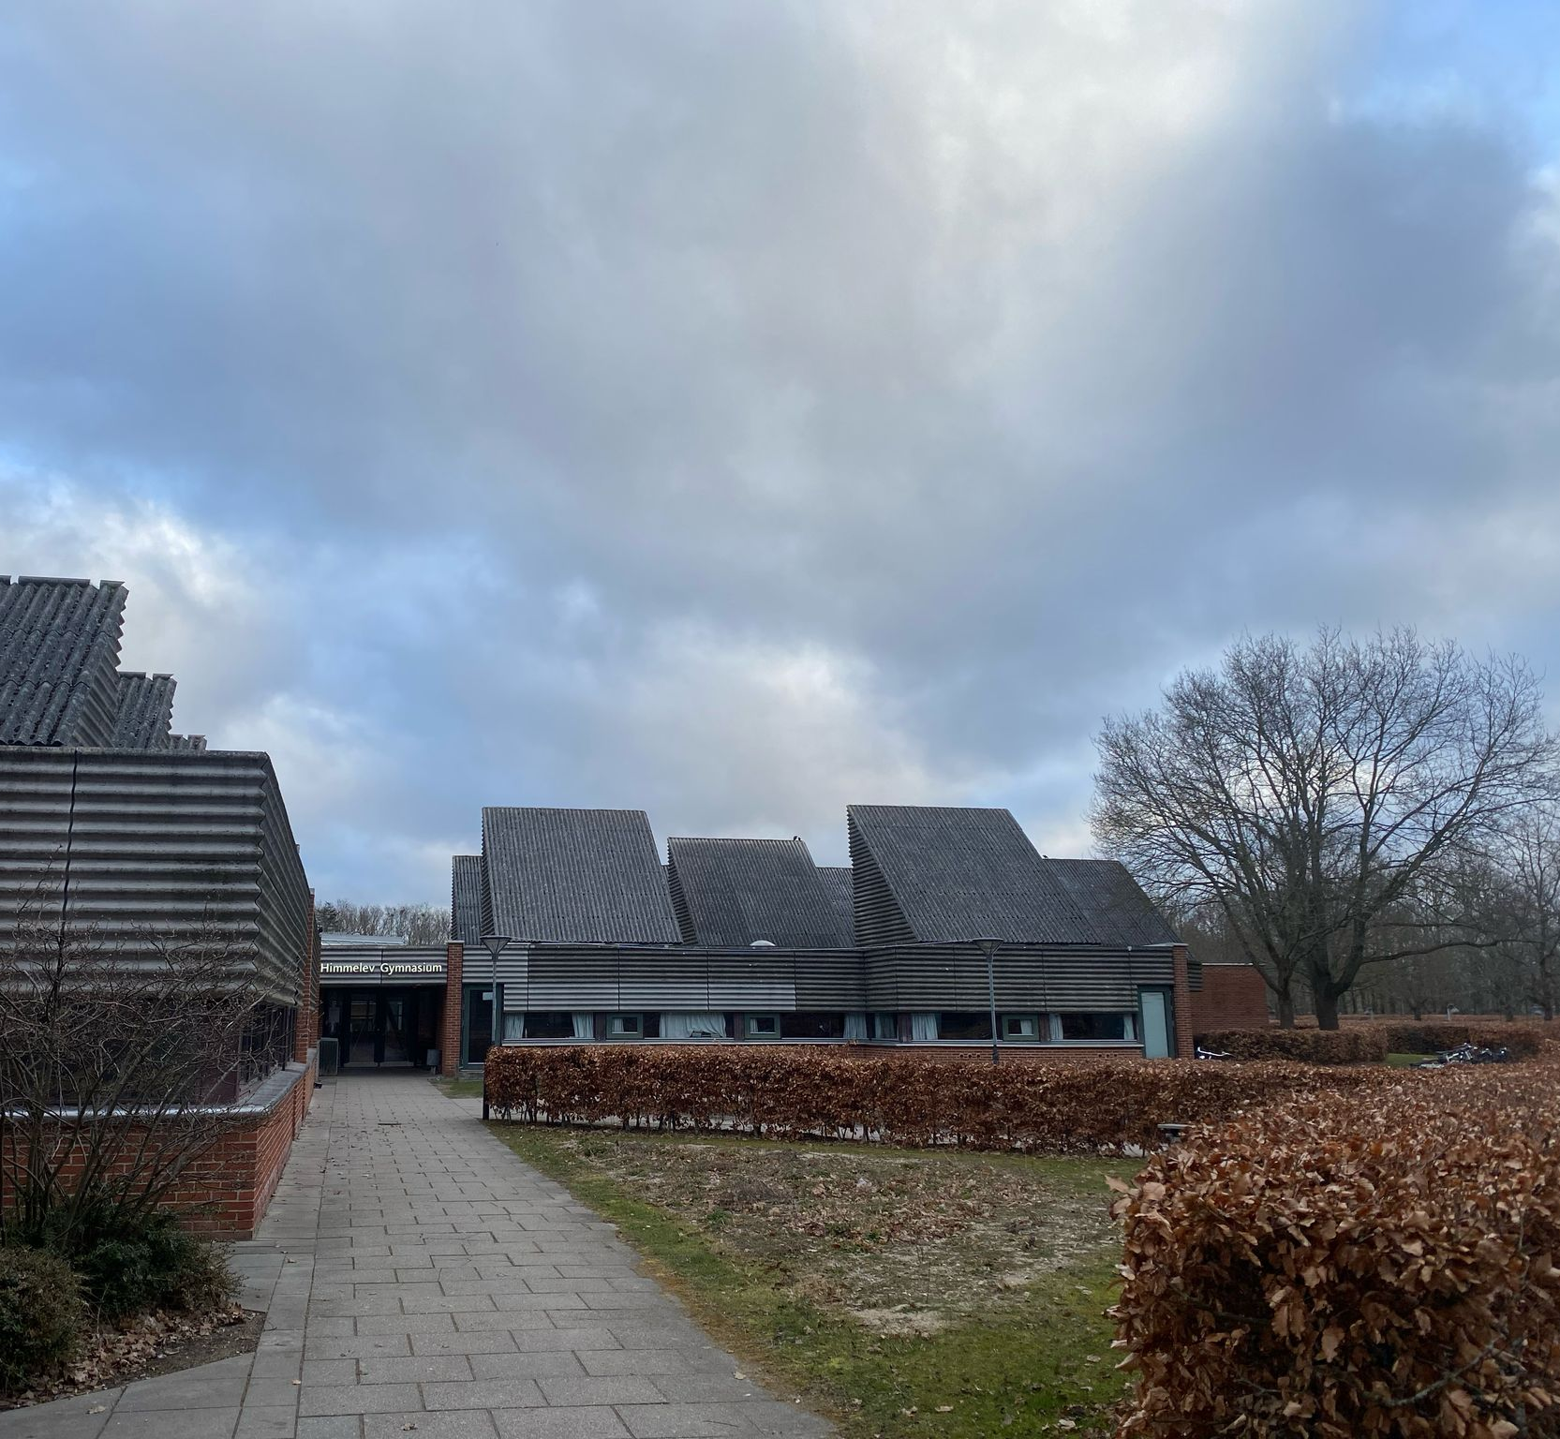
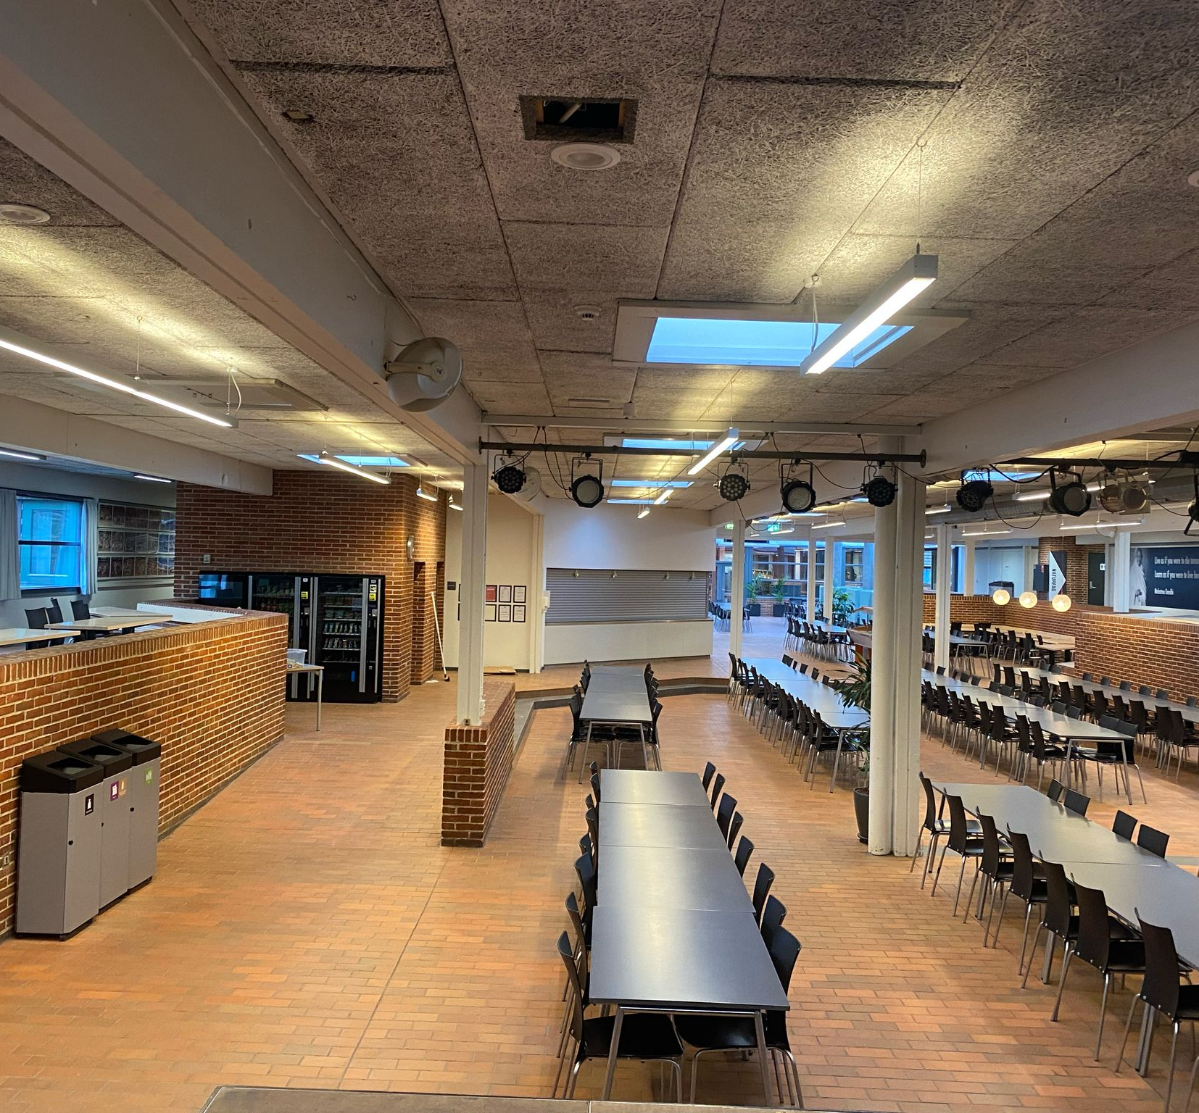
SCHOOL LIFE IN ROSKILDE, DENMARK
Made by Stephanie Sodré and Ludovica Ardiri

Slide 2
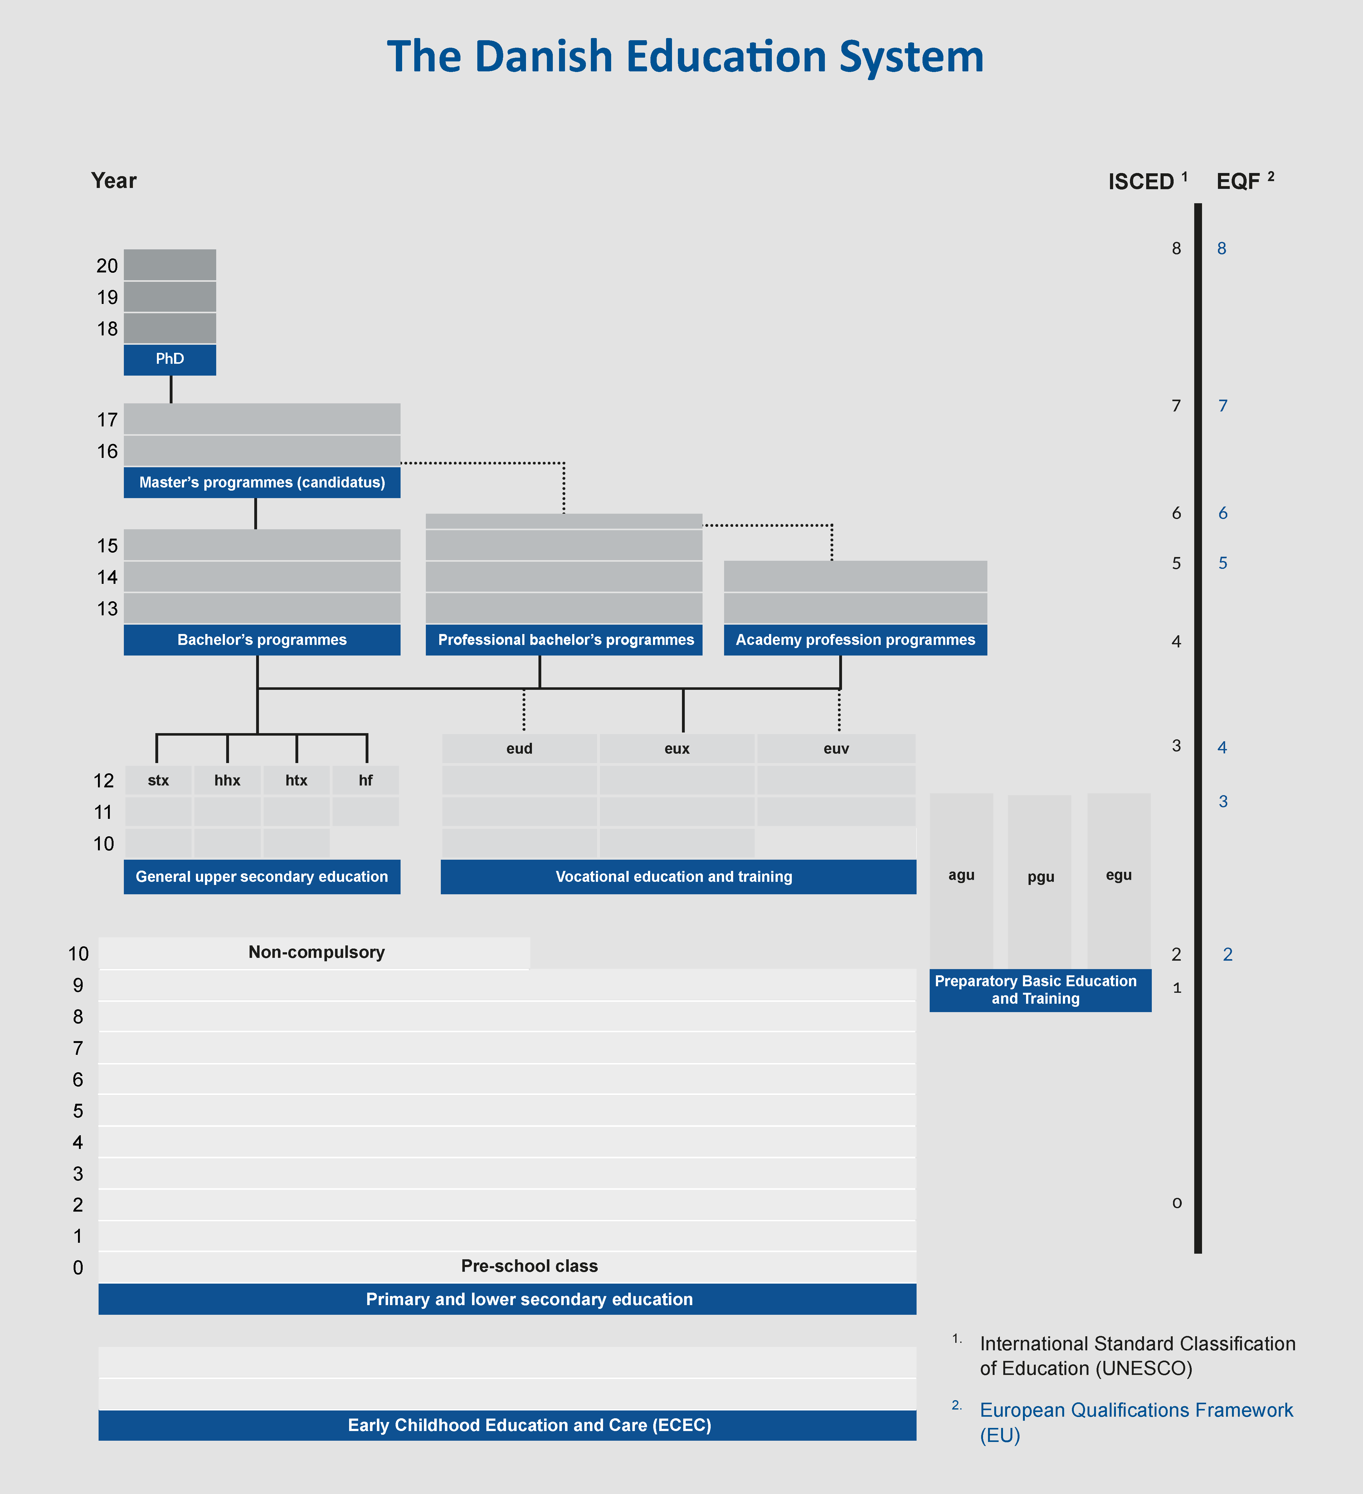
Introduction to the Danish school system
Folkeskole (Primary and Lower Secondary School)
Ages: 6 to 16 (Grades 0–9)
Compulsory education lasts 10 years (includes an optional Grade 10)
Focuses on general knowledge, social development, and creativity
Students don’t take formal exams until the final years
2. Upper Secondary Education
Ages: 16 to 19 (Voluntary)
Two main types:
General upper secondary education (e.g., STX, HHX, HTX): Prepares for university
Vocational education and training (VET): Combines school and apprenticeships, prepares for work
3. Higher Education
Includes:
Academy Profession Programs (short, practical)
University College Programs (professional bachelor's)
University Programs (academic bachelor's and master’s degrees)
Tuition is free for EU/EEA citizens

Slide 3
A Day in the Life of a Danish Student
These are some information we gathered from danish students that we talked with abouut their life in a school day:
School usually starts around 8:00 AM and ends between 1:00 PM and 3:00 PM, depending on the age and grade.
Students don’t have the same schedule every day — some days may be shorter or longer.
There are breaks between lessons, and students often have a longer lunch break in the middle of the day.
Danish schools value a healthy work-life balance — stress is avoided where possible.
Homework loads are usually moderate, and students have plenty of time for hobbies, sports, or social life.
There is a strong focus on student well-being and mental health, even during exams.
Students often work in small groups to solve problems or complete tasks together.
Project-based learning is common — students research real-world topics and present their findings. This method encourages teamwork, creativity, and independent thinking, rather than just memorizing facts.

Slide 4
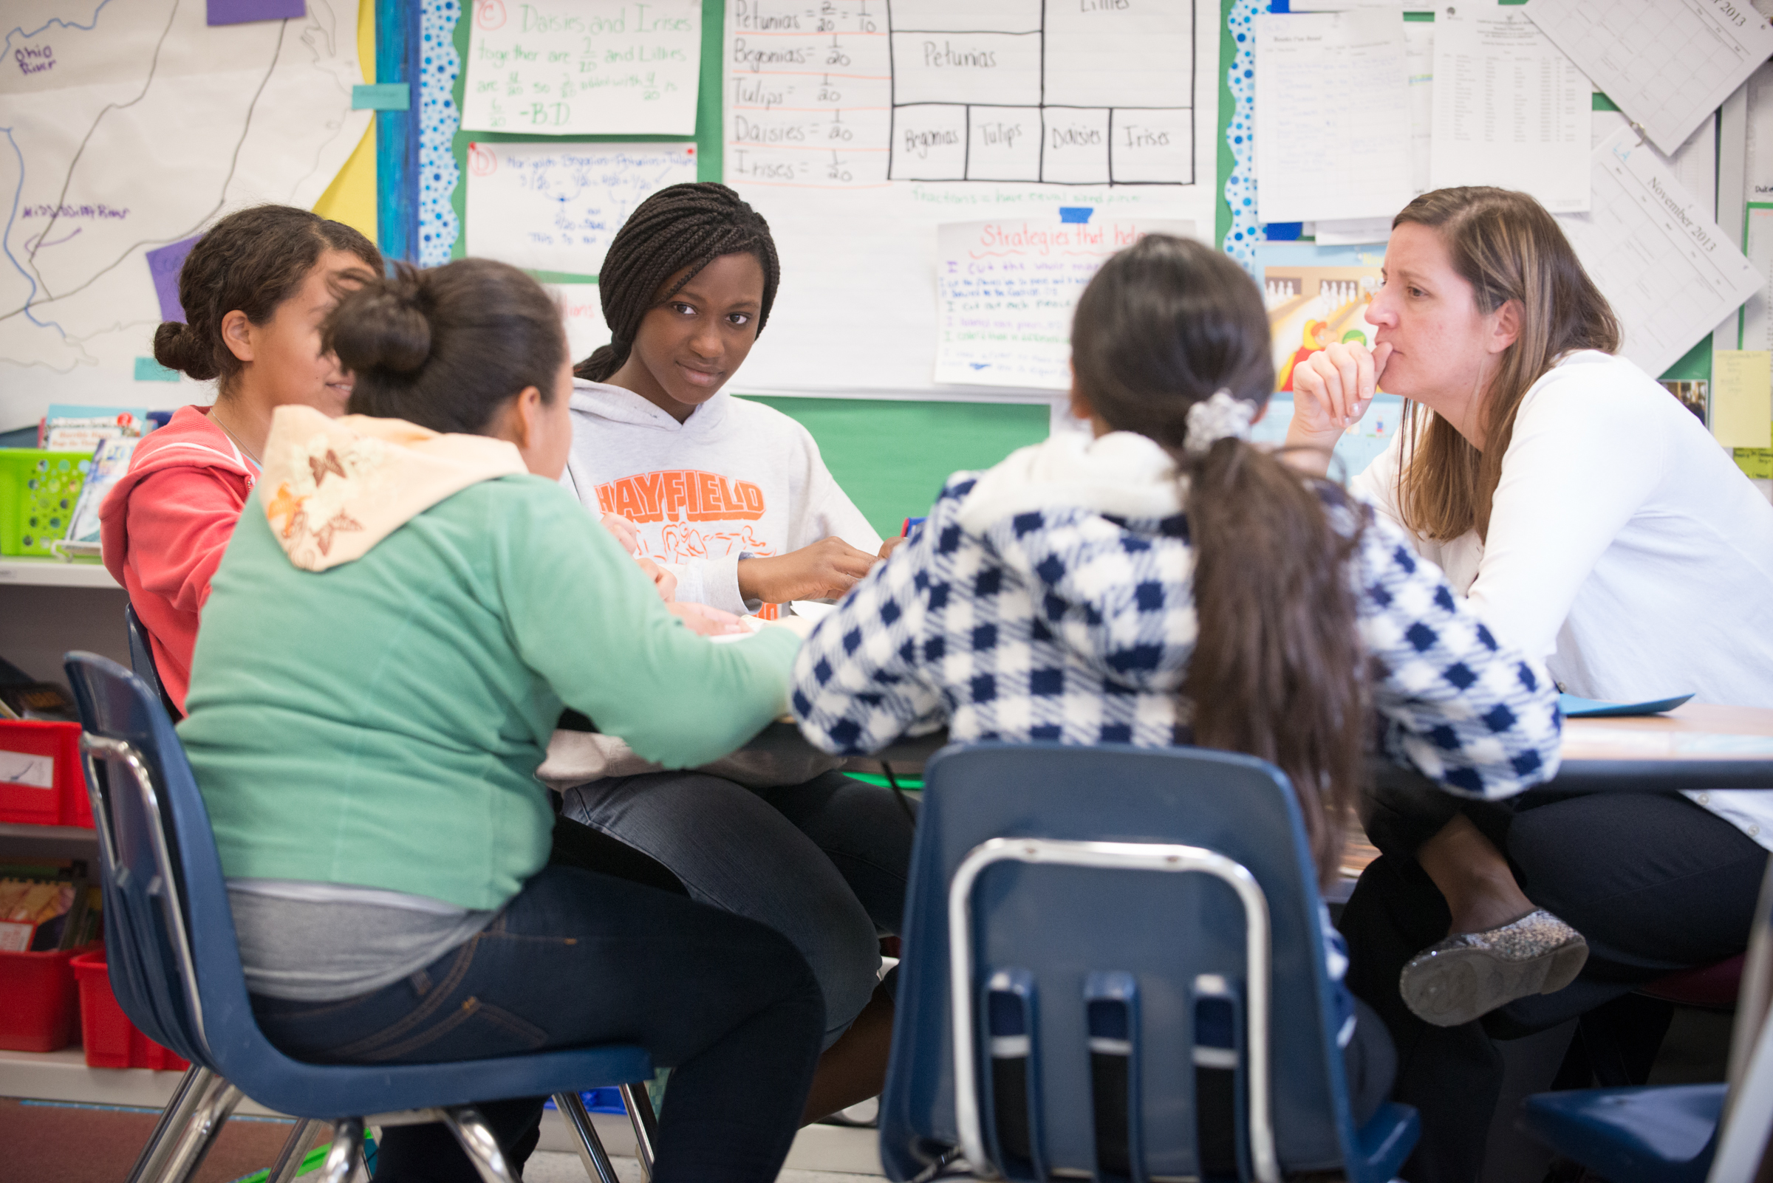
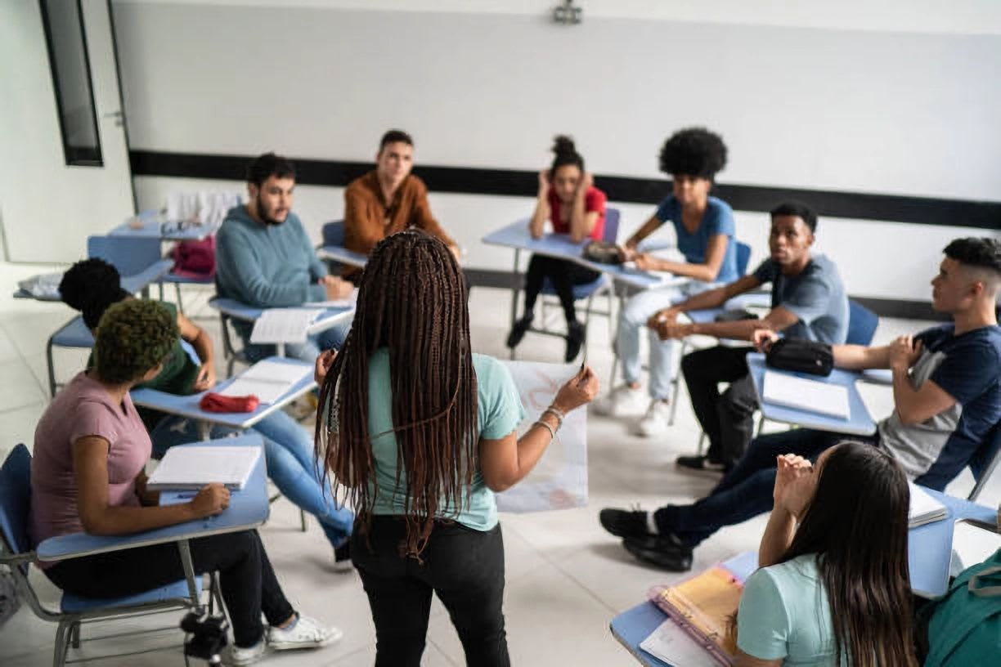
Classroom Environment and Teaching Style
Informal relationships: Students and teachers interact casually and respectfully.
First-name basis: Students call teachers by their first names — no titles like "Mr." or "Ms."
Relaxed atmosphere: Classrooms are calm, friendly, and less strict than in many other countries.
Student participation: Students are encouraged to speak up, share opinions, and ask questions.
Focus on critical thinking: Instead of just memorizing facts, students learn to think, debate, and reflect.

Slide 5
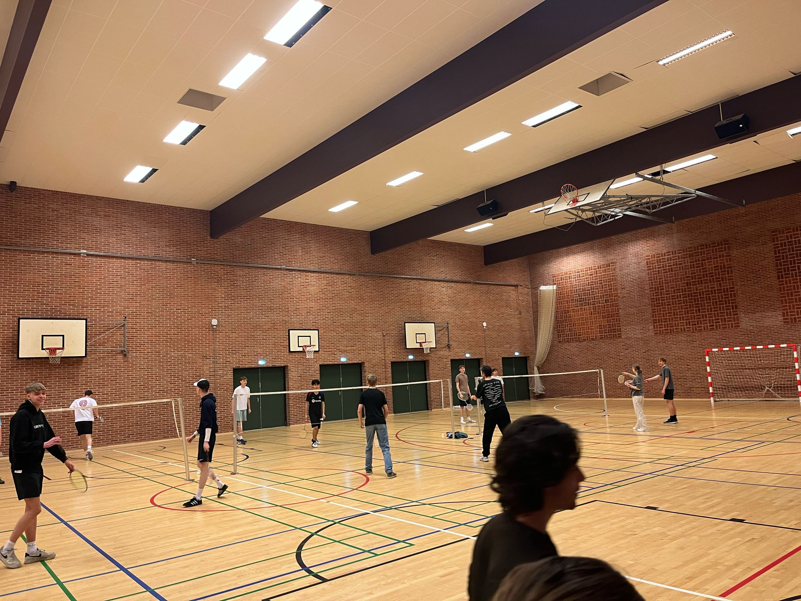
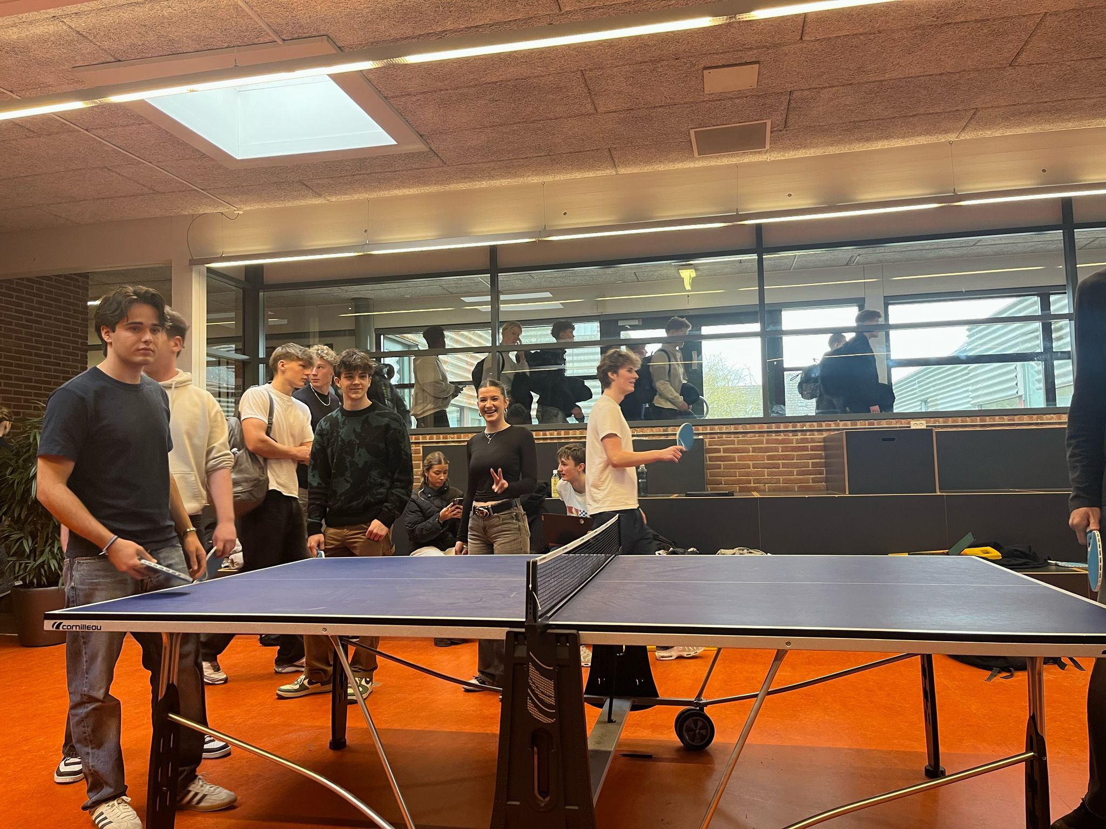
Social Life and Extracurriculars
School Clubs & Activities
Danish schools may not have tons of clubs, but students often join sports, music, or youth programs outside school.
Sports like handball and football are very popular.
Socializing In & Outside of School
Students often spend time together during breaks, lunch, and after school — usually in a relaxed way.
Parties and Prom
Many schools organize school parties (skolefester) during the year — often with music and dancing.
In upper secondary school, there’s a graduation celebration called “studenterfest”, and sometimes a prom-like event.
Students wear student caps (studenterhue) and ride around in decorated trucks to celebrate graduation — a big Danish tradition!
Hygge – The Danish Way of Being Together
Hygge is all about coziness, connection, and comfort — it’s part of how Danish students bond in school.

Slide 6
Some diferences between Danish and Italian school
1. Teaching Style
Italy: More traditional; teachers lead lessons and students take notes. Focus on memorization and written tests.
Denmark: More relaxed and interactive; students are encouraged to discuss, ask questions, and work in groups.
2. Student-Teacher Relationship
Italy: More formal – students address teachers with titles like “Professoressa” or “Professore.”
Denmark: Very informal – students call teachers by their first names and speak openly in class.
3. School Schedule
Italy: Usually Monday to Friday/Saturday, with mornings only, only one brek; homework is often heavy.
Denmark: Usually Monday to Friday, full days with breaks; less homework and more focus on free time.
4. Assessment
Italy: Frequent tests, both written and oral; final exams are very important.
Denmark: Fewer exams, more focus on projects, presentations, and group work.
5. After-School Life
Italy: School ends at 1 or 2pm; students study at home or go to private lessons;
Denmark: Students often join extracurriculars, work part-time, or spend time socializing.

